Slide 2
Personal Growth.
Global Impact.
Feed the Roots.
Mick Schwedler, P.E., LEED AP
2021-2022 ASHRAE Society President
Notes:
ASHRAE’s growth is, and always has been, a direct result of our members’ personal growth.
Today we’re going on a journey and we’ll see that since its inception, our Society has focused on that individual growth.
We’ll explore our rich history, not for history’s sake, but to appreciate how our founders established three sets of roots to help us grow – and how nourishing these roots led to our society’s global growth and impact.
Then we’ll come full circle to understand the importance for each of us to “Feed the Roots” today, and for future generations.

Slide 3
Our Heritage – Our Roots
1894
1894
Notes:
ASHRAE’s heritage, our roots, begin in 1894 when 75 engineers meet in New York City and found our predecessor, the American Society of Heating and Ventilating Engineers, or ASHVE.

Slide 4
1894: Root One - Personal Growth
“…members will have the opportunity of forming acquaintances, exchanging theories and experiences, and through these associations promulgate a feeling of perfect freedom in consulting one another when in doubt on a subject…”
(From Heating and Ventilation, October 15 and November 15, 1894)
Charter Member Harrie Crane of Cincinnati, Ohio
1894
Member-to-Member Connections
Notes:
Charter Member Harrie Crane put into words reasons for founding this Society.
[CLICK] We wanted to form acquaintances – and as many of us have found, lifelong professional and personal friendships.
[CLICK] …to exchange theories and experiences…
Whether it’s been in our workplace, a Chapter meeting or arguing about new designs at a happy hour…we’ve all done this – and often times…vigorously.
[CLICK] And we get to consult and network as we learn from one another.
These establish our Member-to-Member connections.
From 1894 to today, this root of personal growth remains a tenet of our Society.

Slide 5
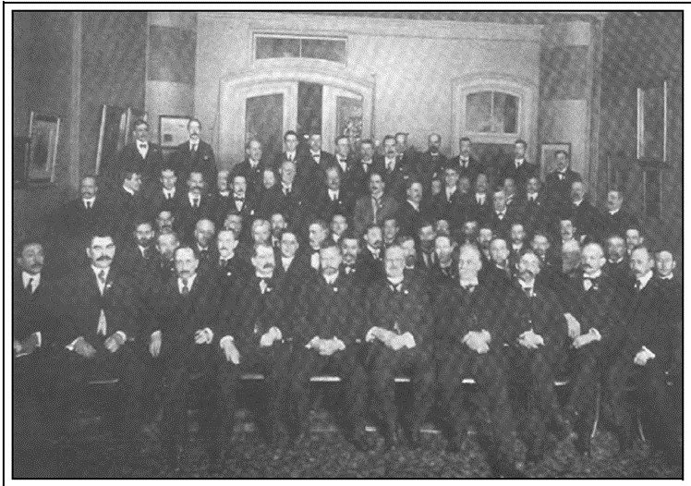
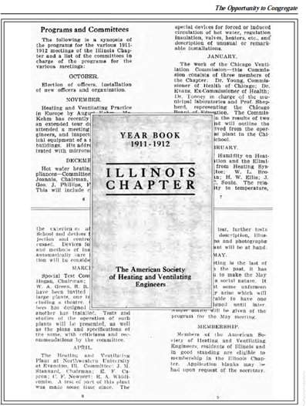
1906: Root Two – Chapters (Grassroots)
Forming acquaintances
Sharing experiences and theories
Consulting one another
1894
1906
Notes:
We now fast forward twelve years to our convention in Chicago.
On July 19, 1906, Illinois Members request formation of a Chapter – sanctioning the “opportunity to congregate.”
[CLICK] This directly follows Mr. Crane’s vision and enhances individual Members’ growth
This second root – known as our grassroots is an ASHRAE hallmark.
These “grassroots” build upon and augment individual member growth. Special thanks to our Illinois members for your foresight.

Slide 6
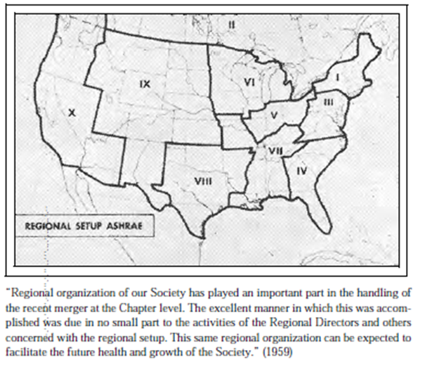
1922 – 1956: Growth in North America
1922
First chapter outside the U.S. in Toronto
1956
72 ASHRAE Chapters
1894
1906
1922
1956
Notes:
Our first Chapter outside of the U.S. was chartered in 1922 , in Ontario, Canada
[CLICK] And by 1956 we had grown significantly and organized into regions, but we were still exclusively North American.

Slide 7
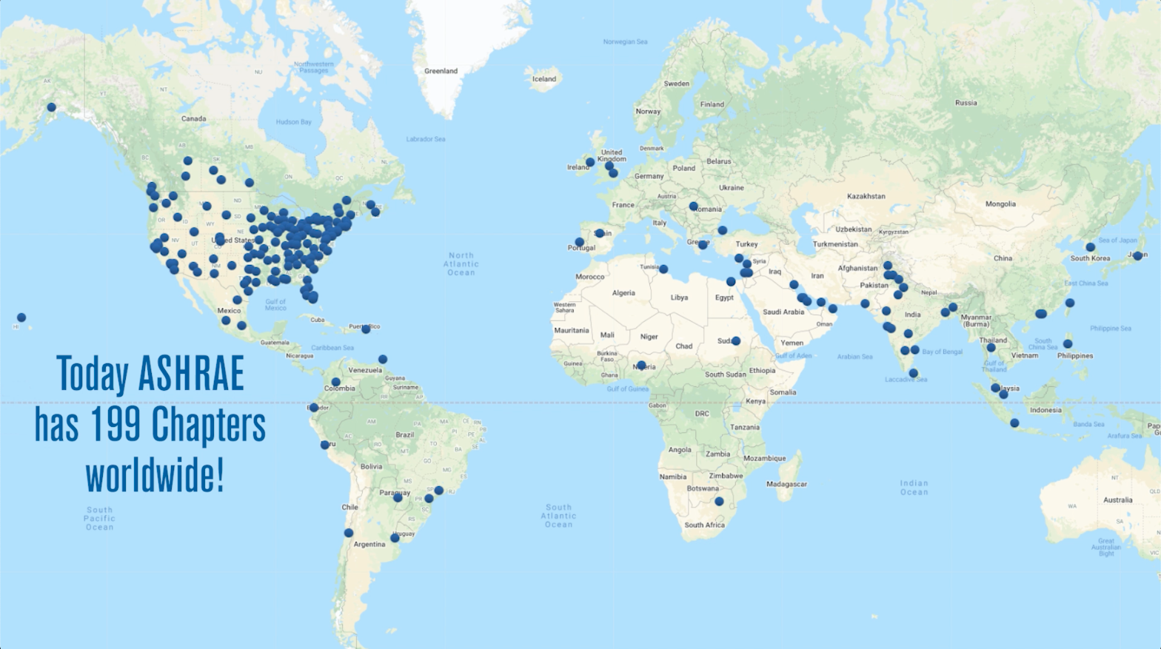
1984: ASHRAE Global Growth Commences
Singapore,
Hong Kong
Cairo
Greece
199 Chapters
India
Mexico City
Brasil
1894
1906
1922
1956
1984
1990
1995
1996
1996
2002
Notes:
In fact, it wasn’t until 90 years after our founding, when our global journey really began with Chapters in [CLICK] Singapore and Hong Kong. [CLICK] Then India, Africa, Mexico, [CLICK] Europe, and South America.
[CLICK] Today we are 199 Chapters with the most recent being Peru, Libya and Alexandria, Egypt.
So, our second set of roots – our grassroots – have spread, strengthened and led to amazing growth throughout the world

Slide 8
Who Fed Your Roots?
Your list
2-3 first names
1894
1906
1922
1956
1984
today
Notes:
Now, let’s pause and ask a question; How did you get here today and become part of this expansive root system?
Who helped you grow, encouraged you, that is, who “fed your roots”?
Please take out a paper and pen, your phone or computer to make a list.
[CLICK] Now take 10 seconds to physically list the first names of 2-3 people who invested in you – and helped you grow. That is…fed your roots. Please make your list.
[CLICK] Here’s a collage of people who fed the roots of President-Elect Advisory committee members…those involved in developing this year’s Society theme.
For many of us, it’s probably hard to narrow down to 2-3 names.

Slide 9
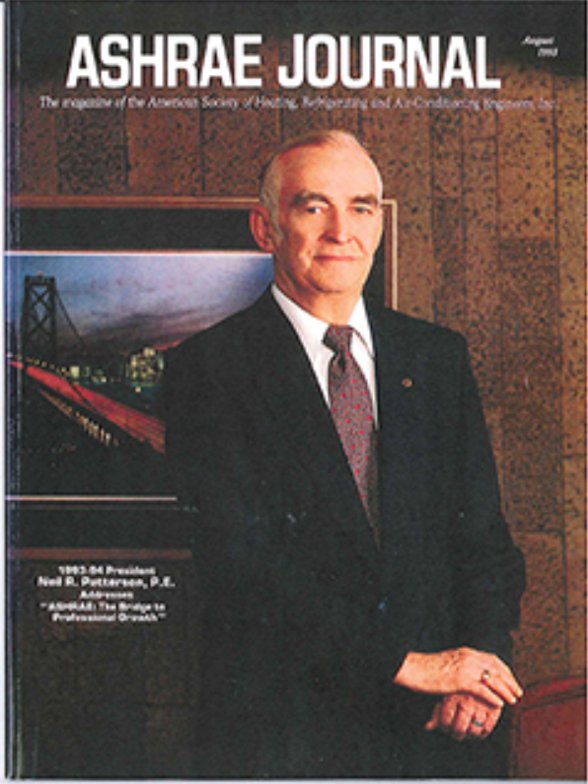
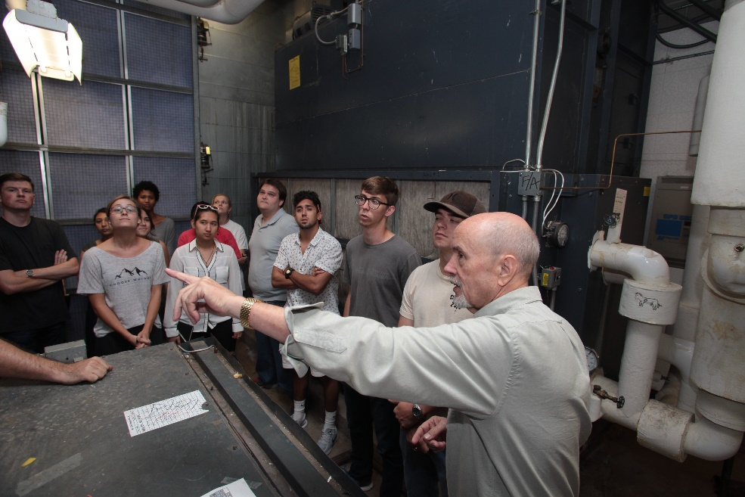
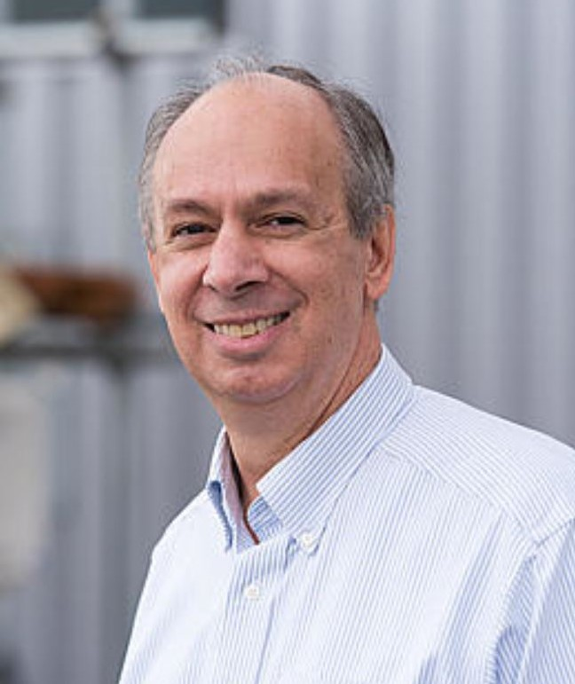
Who Fed My Roots?
Charlie Culp
1981: Neil Patterson
Mike Brambley
Connect a Colleague today
ashrae.org/connect
Notes:
It was for me.
So many have guided and helped mold me, but here are the first .
[CLICK] In 1981 I received a job offer from a group led by Neil Patterson. At that time I didn’t realize that Neil would become ASHRAE President about a decade later. And, we didn’t have today’s simple and polite way to connect a colleague to ASHRAE.
But Neil had his own “connect a colleague” method. I recall his words were, “…you will be involved in ASHRAE,” and then he provided the support to do so.
That support resulted in attending Technical Committee meetings. The first two TCs weren’t good fits. Then, one Monday evening, I walked into TC 1.5, Computer Applications
The leaders, including Charlie and Mike, invited everyone to “the big table,” – to be involved. They encouraged and mentored me as I foundered in my first subcommittee chair assignment, and even convinced this new, naive member to be TC secretary for not two, but FOUR years as they restructured the TC.
All have been amazingly supportive mentors. Neil has passed away, [CLICK] but today, thanks to Charlie Culp and Mike Brambley for feeding my roots.

Slide 10
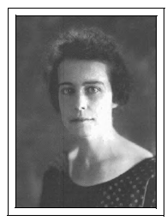
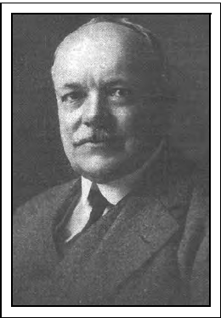
1917: Root Three - Technology
ASHRAE Research Bureau
F. Paul Anderson
Margaret Ingels
Research subcommittees led to Technical Committees
Handbooks
Education
Standards
1917
1894
1906
1922
1956
1984
Notes:
Now, on to our third root, technology, and the1917 decision to found our Research Bureau.
Later led by F. Paul Anderson and one of or first female members, Margaret Ingels, here we are – over a century later still independently funding our research.
To oversee the research, subcommittees were formed.
[CLICK] These were precursors of our present Technical Committees – now responsible not only for research, but also our Handbooks, conference sessions, and identification of Standards. These are our deep technical roots.

Slide 11
Personal Growth
+
United Efforts
Global Impact
…to serve humanity
Notes:
These three sets of roots put in place by our founders have spread globally to our membership of more than 53,000.
As volunteers we’ve grown personally, gathering and serving – in our grassroots Chapters and Regions, and through our technical contributions.
[CLICK] …and by uniting we’ve had global impact
[CLICK] … to serve humanity…
the first three words of our Mission..
Let’s look at just a few of these global impacts.

Slide 12
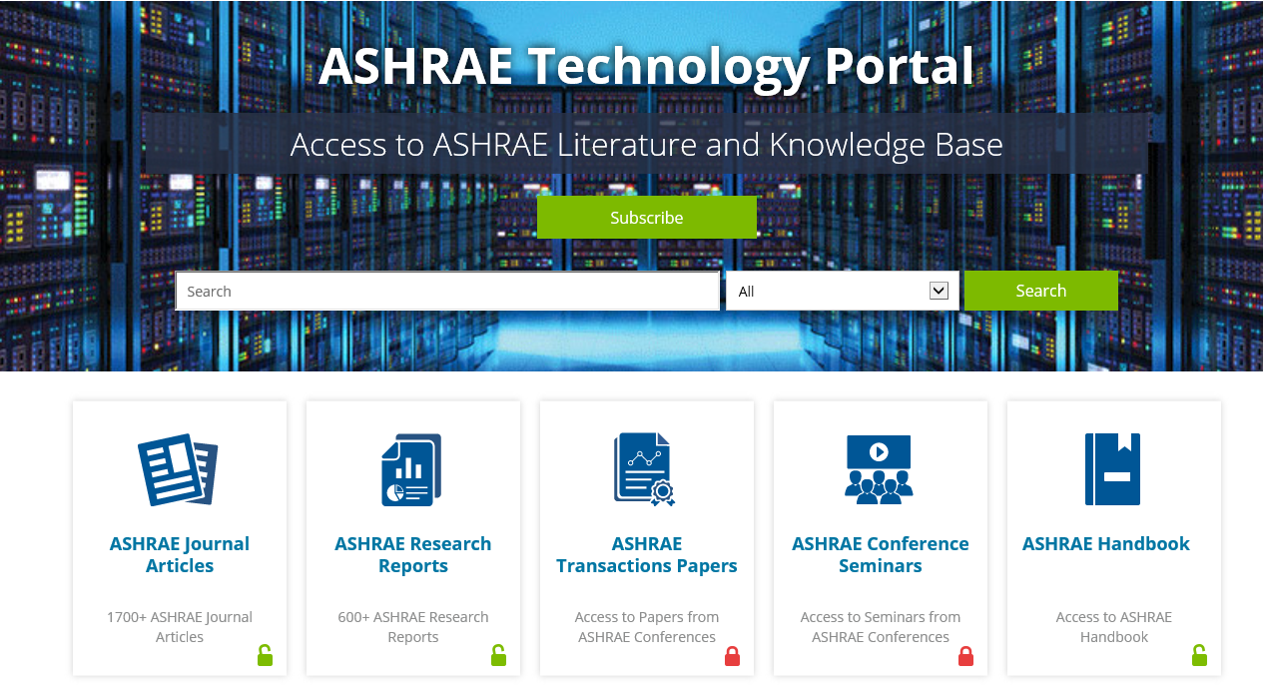
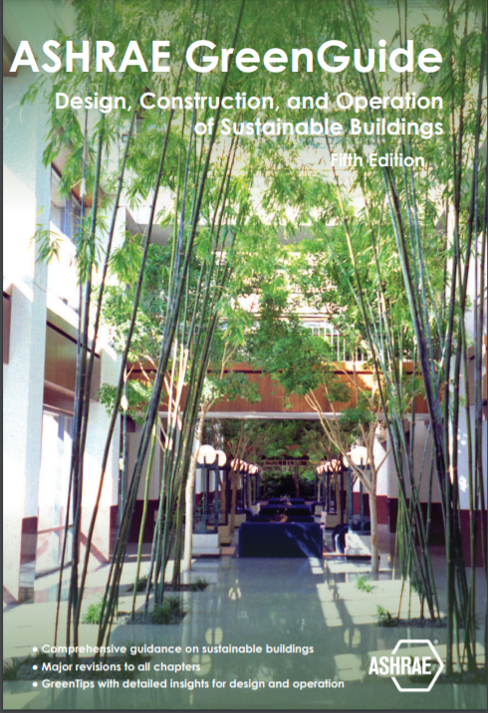
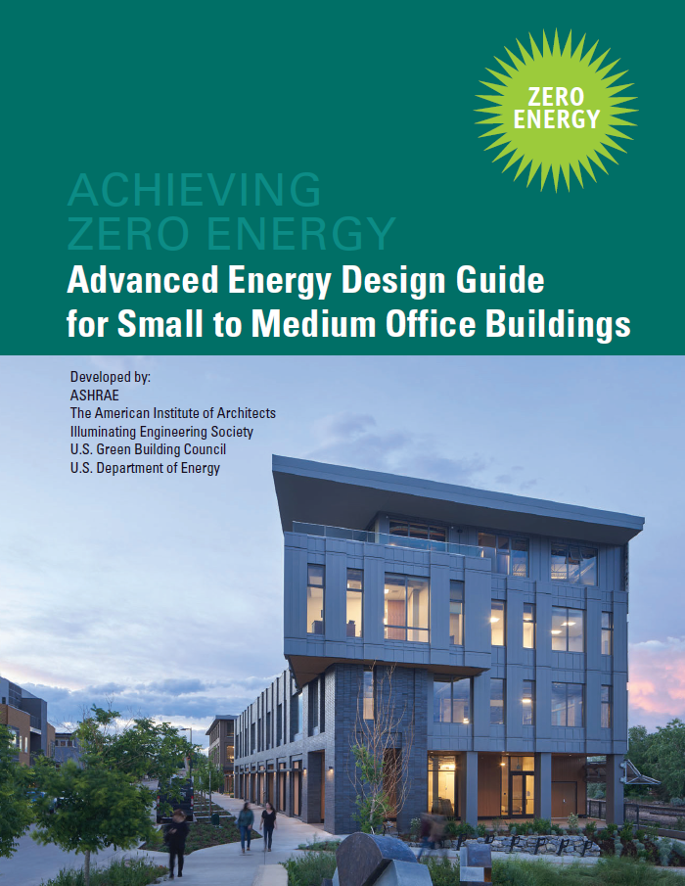
Global Impact: Education and Training
technologyportal.ashrae.org
Notes:
First. Our technical, education and training materials are well-known and respected worldwide…and available to everyone through our technology portal.
They help ensure the built environment is efficient, resilient, reliable, and addresses our world’s ever-changing needs.

Slide 13
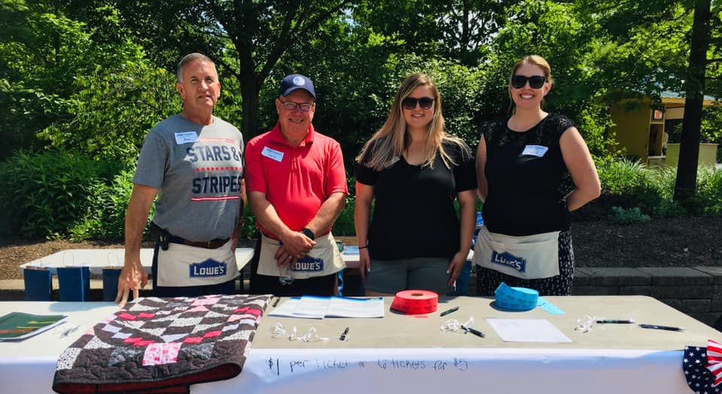
Global Impact: ASHRAE Member Funded Research
Over $78,000,000 donated since 1959
Society Year 2019-2020 total raised: $2,117,677
$1,635,596 in contributions for Research
$277,720 for ASHRAE Foundation
$170,596 for Scholarships
$33,765 for General Fund, YEA, and Education
ASHRAE Cincinnati Chapter RP
Notes:
Next, in the last 104 years you and members like you have funded research
including more than 2 million dollars last year.
[CLICK] and since 1959 more than 78 million dollars. Thank you.
This leads to quality, independent research.

Slide 14
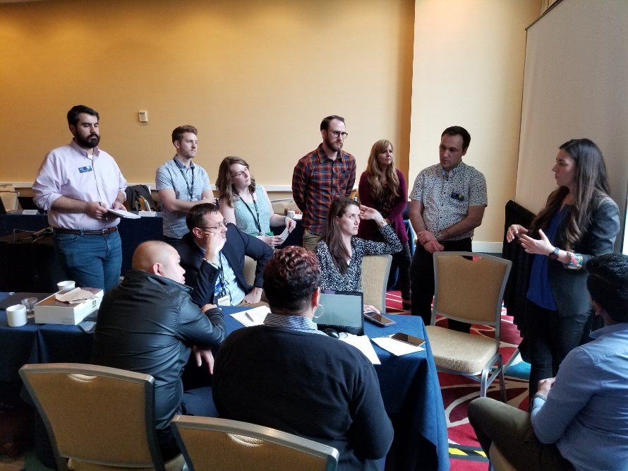
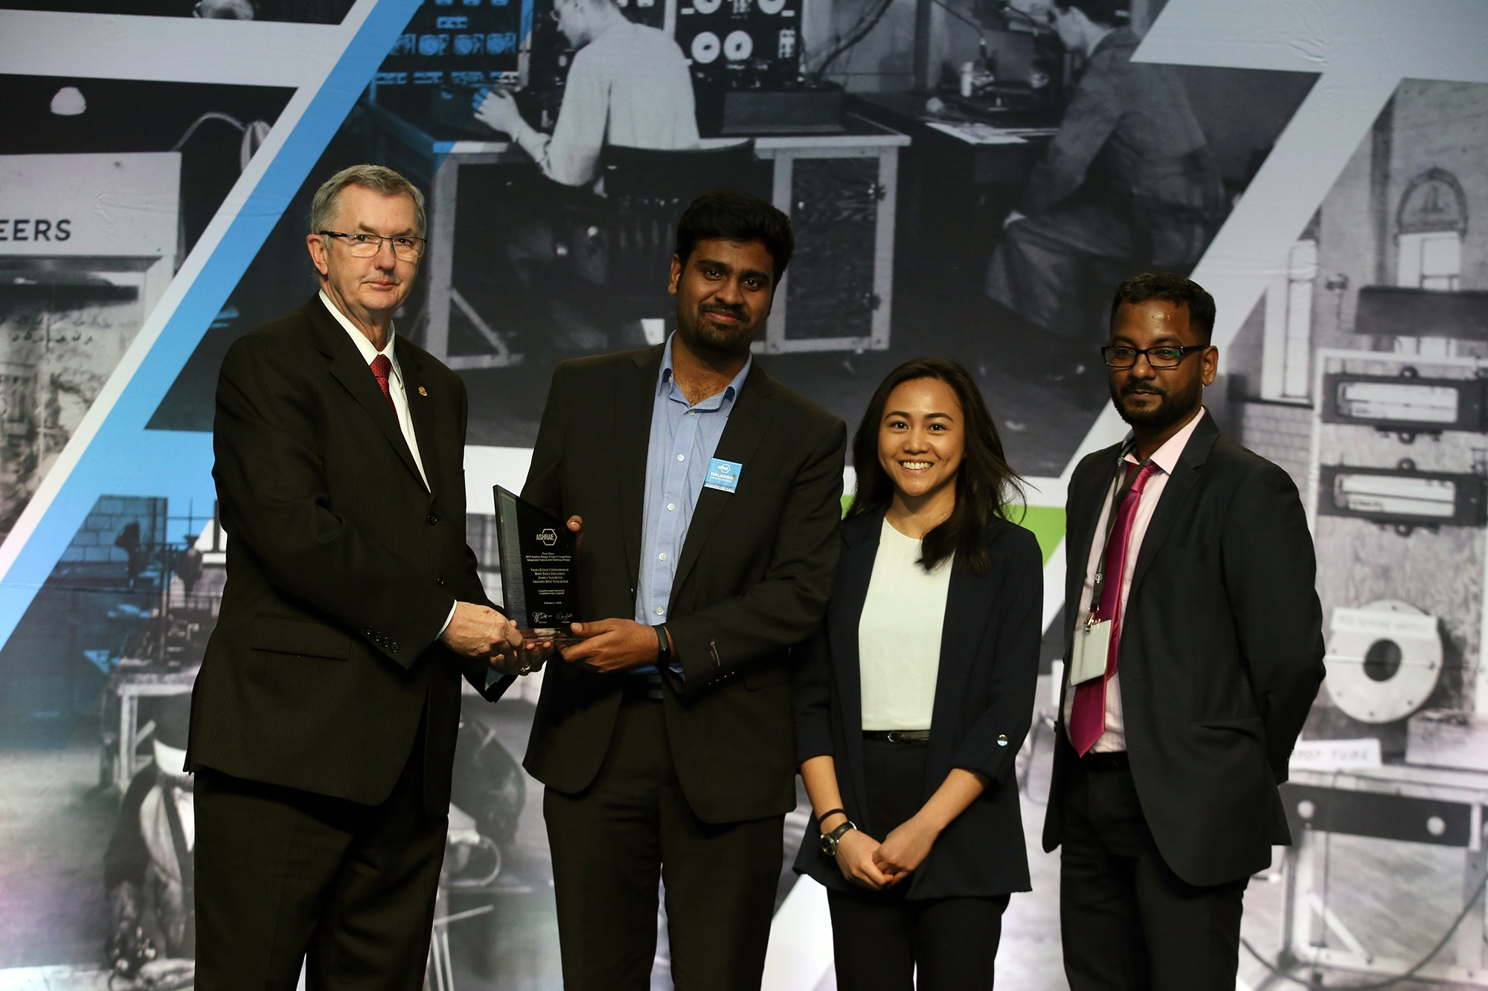
Global Impact: Young Engineers in ASHRAE (YEA)
Members 35 and younger
~20% of membership
Now leading us into the future
Notes:
As a Board Member I’ve had the privilege to represent ASHRAE at other organizations’ conferences
Many of those associations absolutely covet our Young Engineers in ASHRAE, known as YEA – [CLICK] who are now about 20% of our membership.
YEA was a vision of many, and the young women and men who began in YEA are now leading us into the future and providing strong connections to young professionals and students entering our industry.

Slide 15
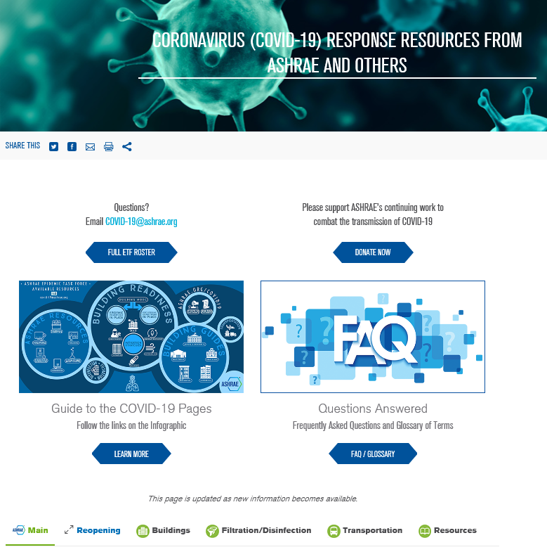
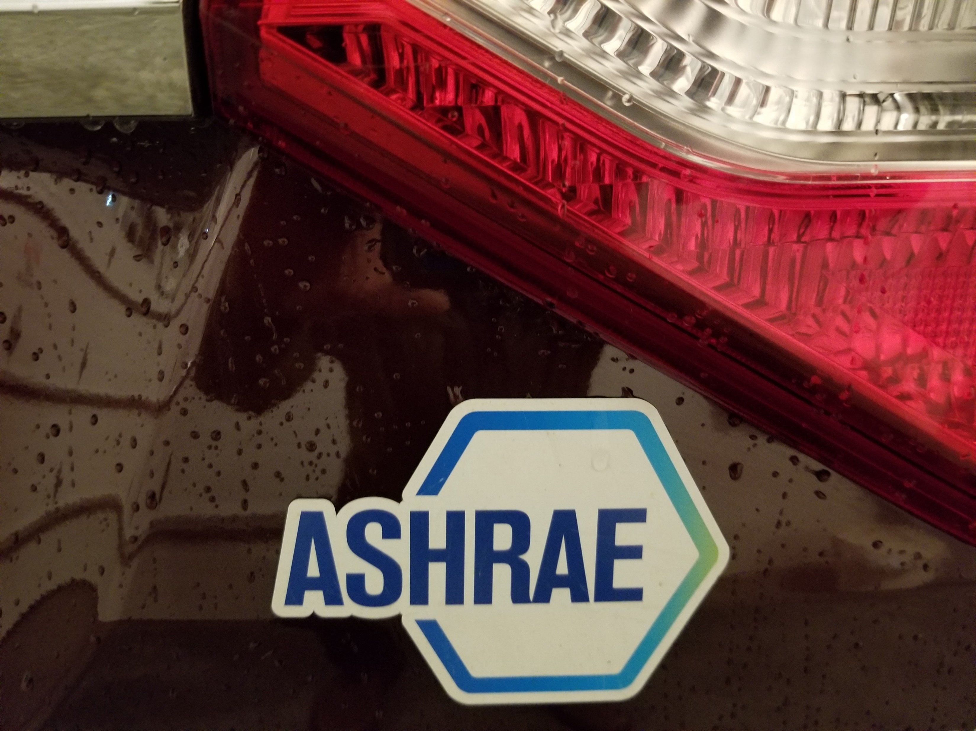
Global Impact: Epidemic Task Force
Mitigate the spread of disease
Information to reopen buildings
Educate building owners and operators
ashrae.org/covid19
Jen’s ASHRAE Car Magnet
Notes:
And our most recent global impact is our Epidemic Task Force. Through volunteer efforts of more than 130 experts,
[CLICK] ASHRAE is a beacon, providing needed information to mitigate the spread of disease, reopen buildings, and deliver education for building owners and operators.
All to improve Indoor Environmental Quality – and keep people safe. The impact has been global, and touched each of us locally.
This hit home personally.
[CLICK] My wife, Jen, has an ASHRAE magnet on her van, and was speaking with her college roommate who works for the La Crosse County Health Department.
… Jen’s college roommate said, “ ASHRAE, we use their information.”
THAT is impact.

Slide 16
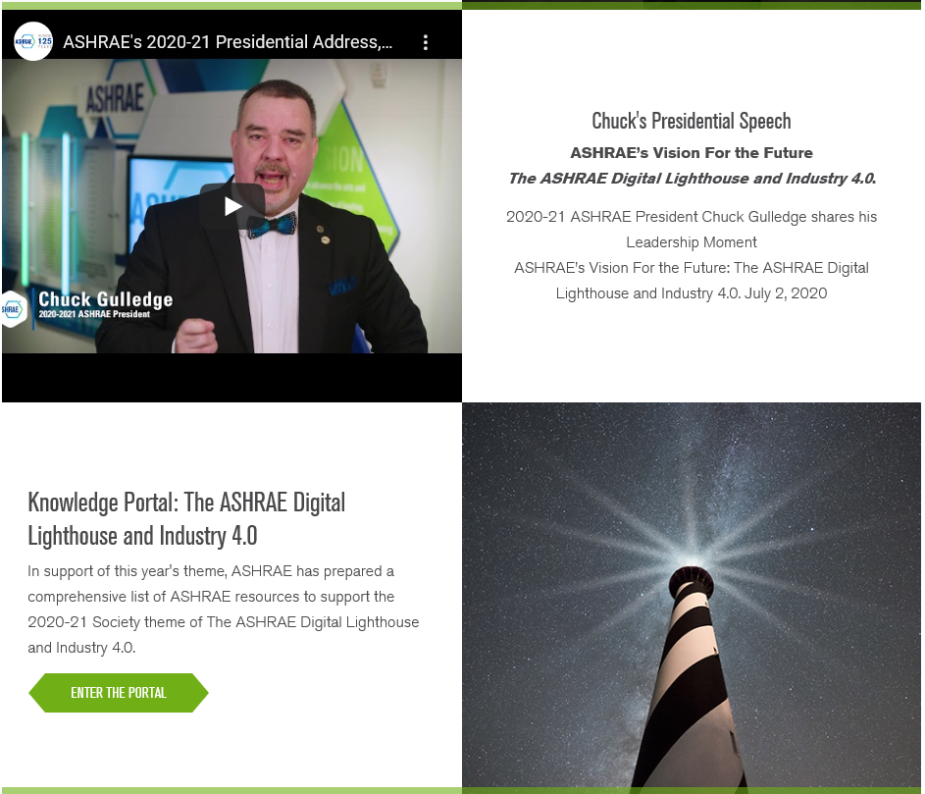
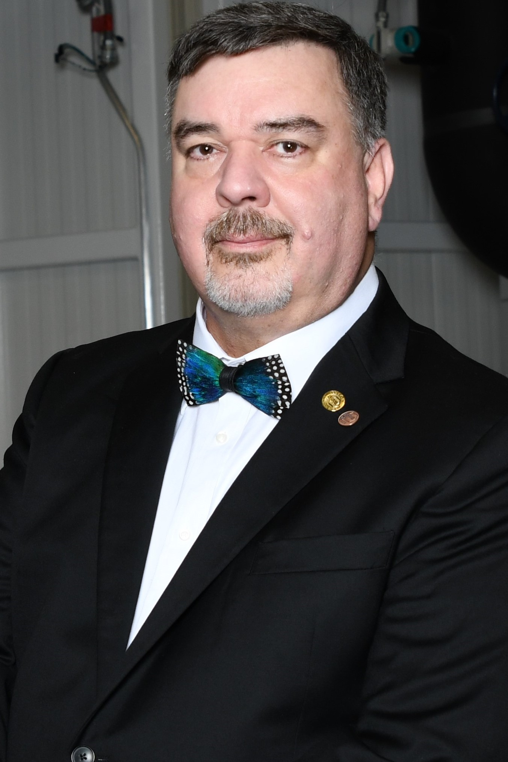
2020-2021: Embrace Technology to Become Fully Digital
Thank you to 2020-21 ASHRAE President Chuck Gulledge for his guidance and vision
Notes:
In today’s terms, it’s time for a shout-out. We would not have made it through the past 16 months without the guidance, vision and drive of President Gulledge to embrace technology.
Who would have thought we could do our “work,” serve Chapter members and carry on our mission-- without leaving our homes for months.
[CLICK] Chuck, thank you for leading us through these tough times.
But we all know that being fully digital has been hard.

Slide 17
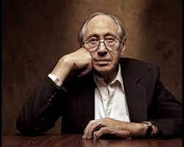
High Tech / High Touch
Alvin Toffler, author of “Future Shock.”
Notes:
This phenomenon was explained by author Alvin Toffler in his 1970’s book “Future Shock.” As our world uses higher technology, we, as people need and crave personal connections – in our case Member-to-Member connections.
[CLICK] To explain this, Toffler, coined the term “High-Tech / High Touch”.
I think we all really understand his point today.
How do we use this to move forward?

Slide 18
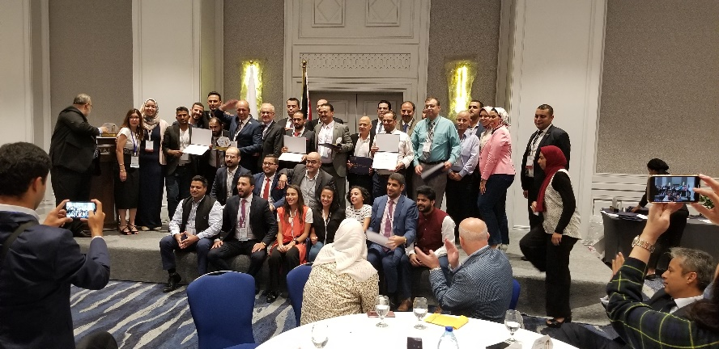
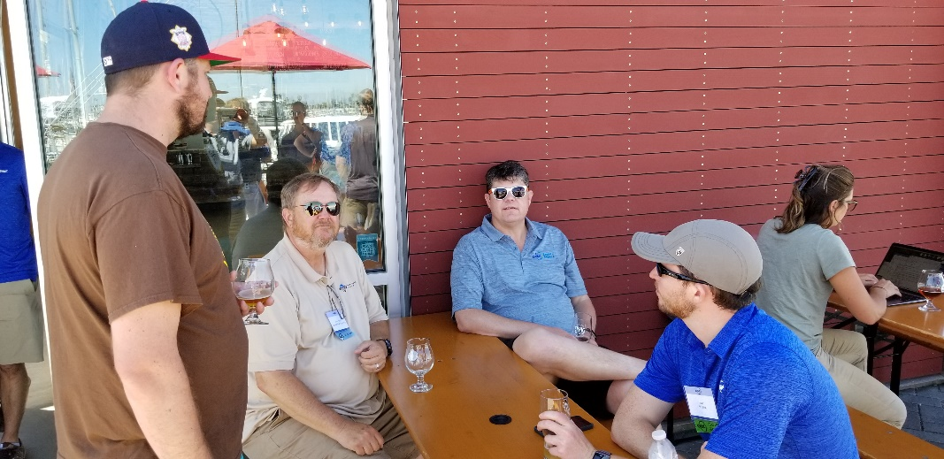
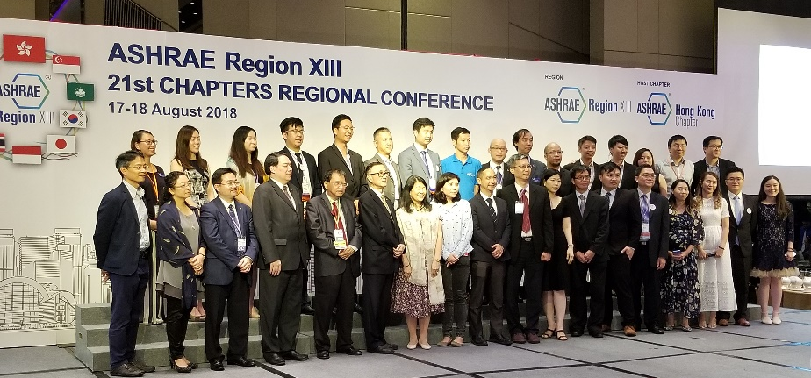
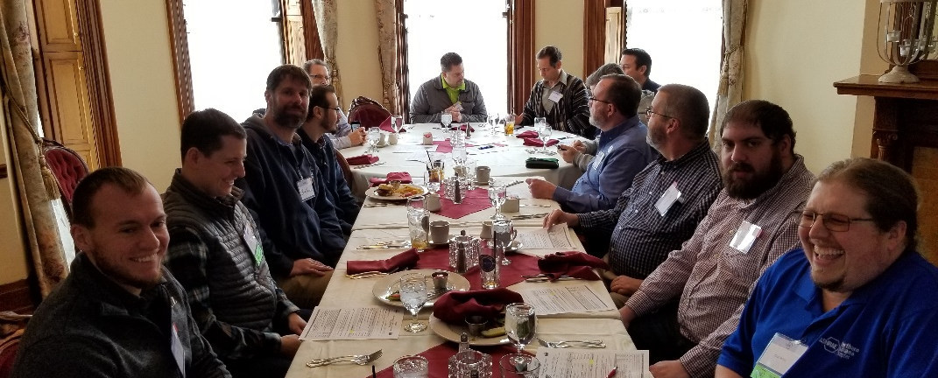
On to Extraordinary!
Do we really just want “normal”?
Notes:
Many times I’ve heard people say, “I can’t wait until things get back to normal.”
Please take no offense, but I don’t think we have any desire for “normal.”
[CLICK] …what we really want is the ‘extraordinary” we have.
We will use our best virtual and personal practices, combined with historical roots,
[CLICK] to move on to extraordinary.
Here’s how.

Slide 19
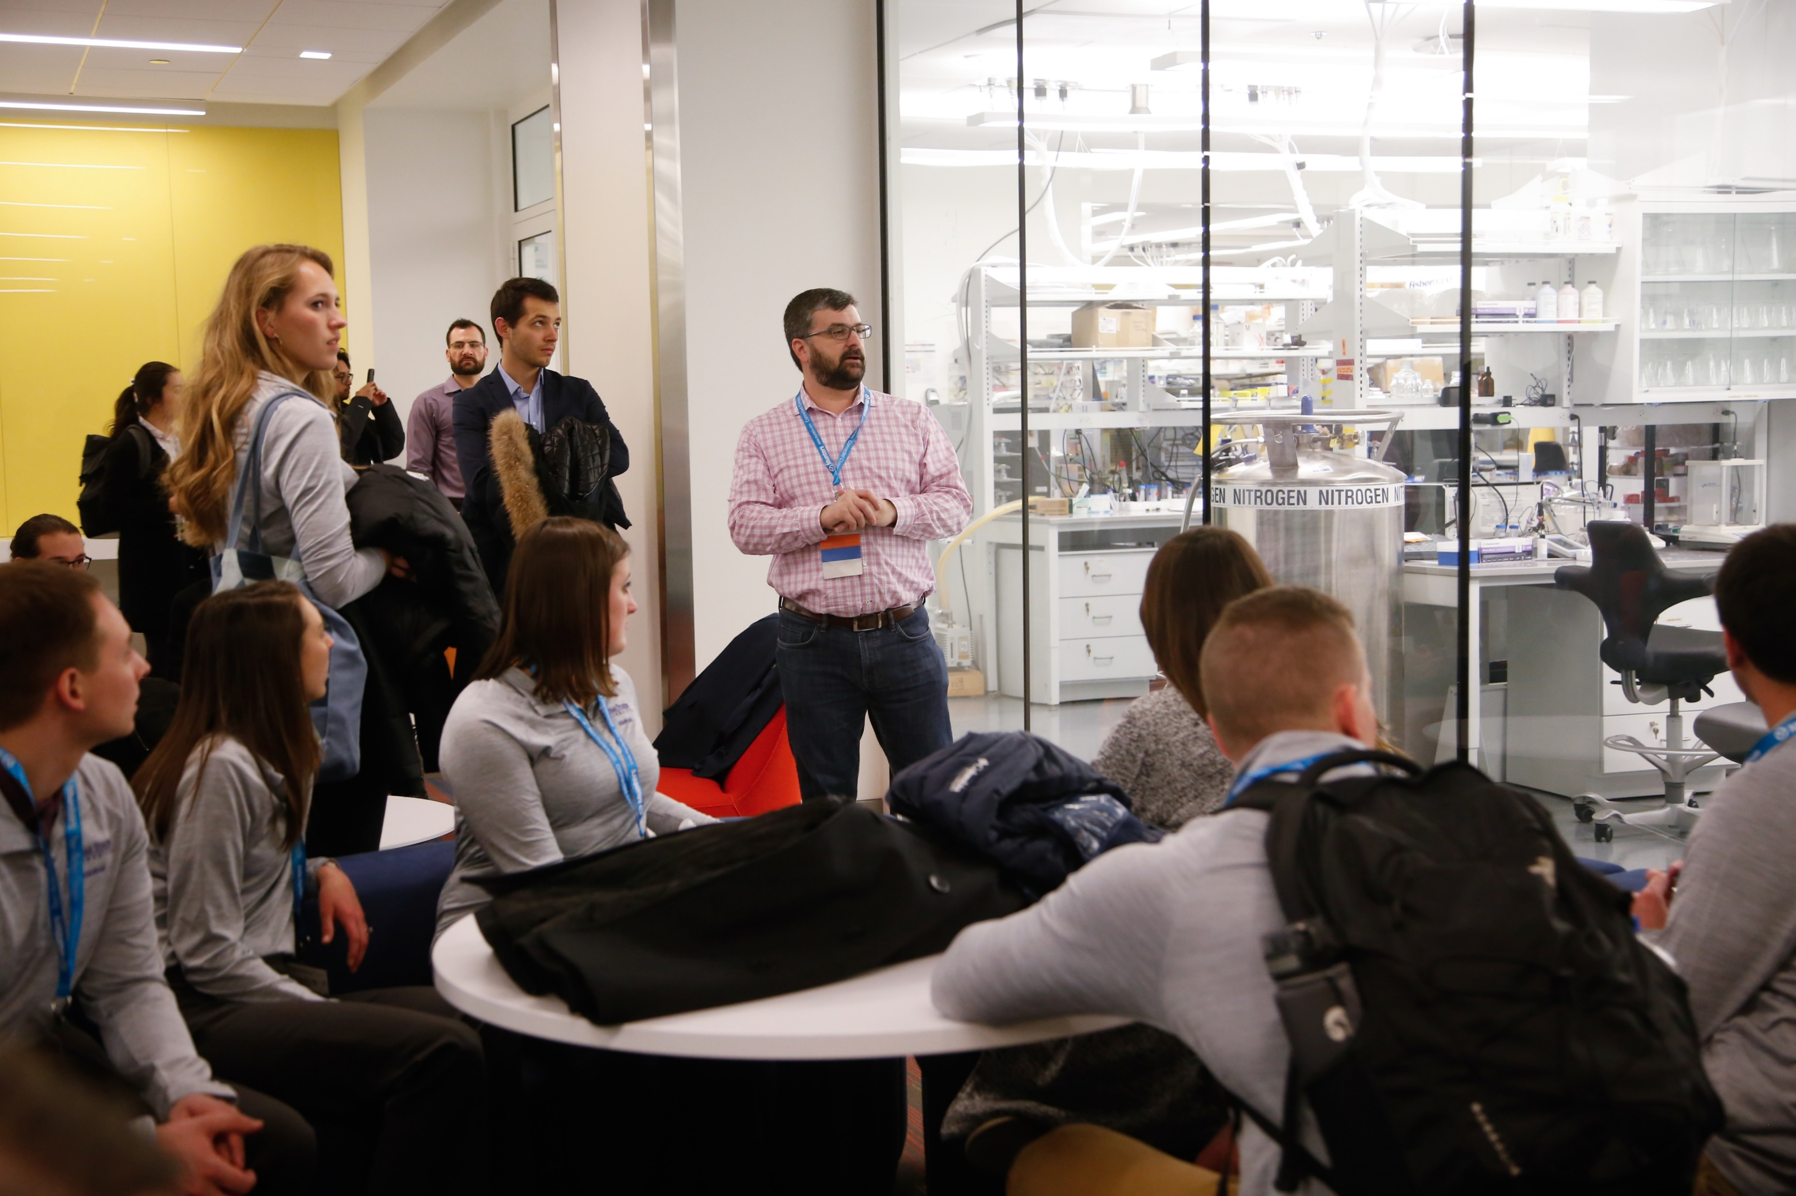
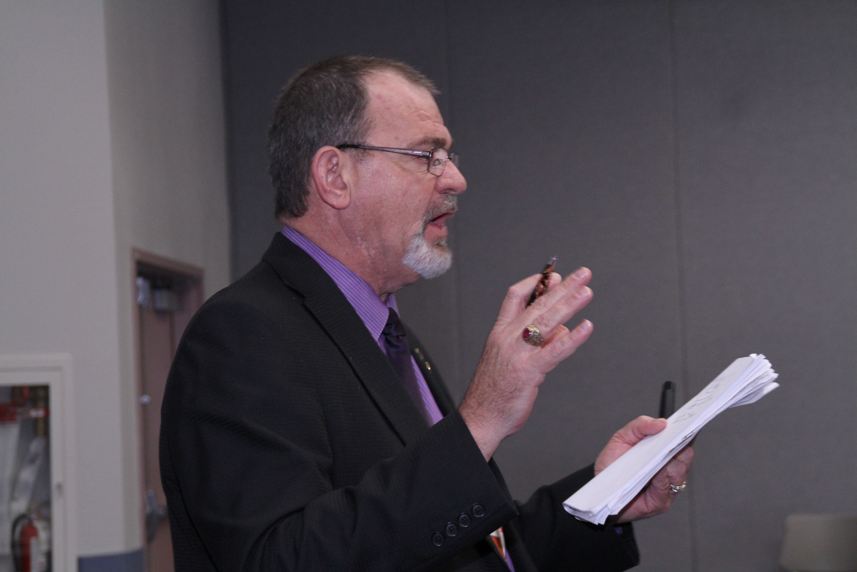
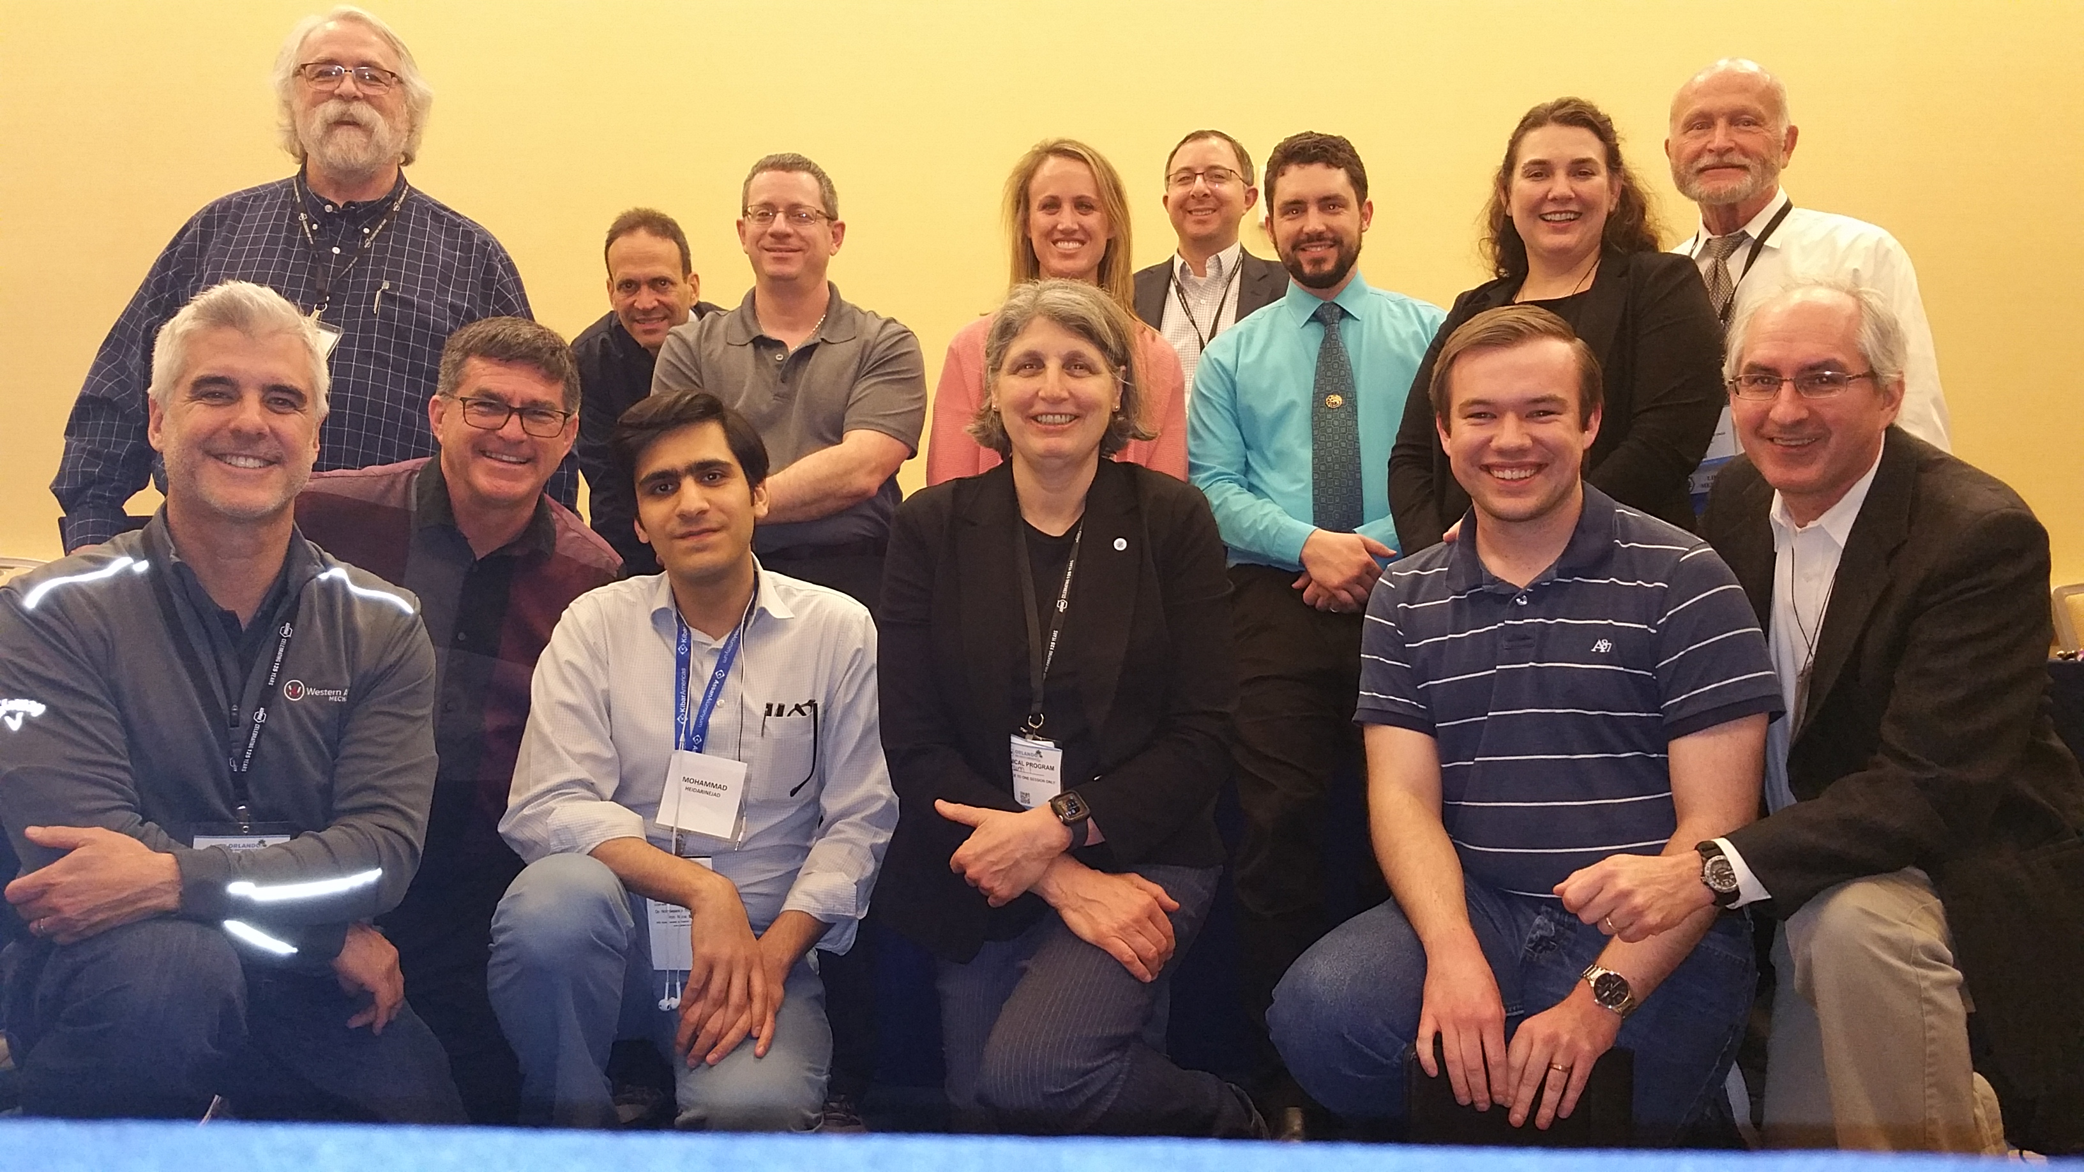
Roots: Technology and Personal Growth
Technical Committees
Research
Distinguished Lecturers
Notes:
Our deep technical roots will continue to be fed through education, training, standards, research and other materials produced by our volunteer experts – delivered both virtually and in person.
[CLICK] The Distinguished Lecturers who present to your Chapters are often described as ASHRAE’s most successful program. They will continue to be available virtually (high tech) and when it’s safe for the Chapters and lecturers, we will get back to face-to-face presentations to provide the high touch.

Slide 20
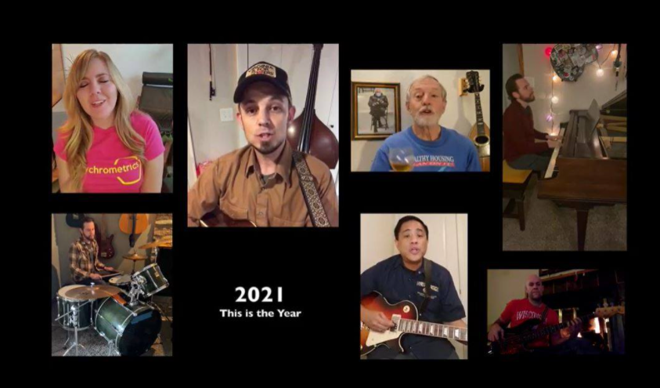
Root Two: Chapters and Regions (Grassroots)
Presidential Award of Excellence (PAOE)
Streamlined
Member-to-Member Connections IntraRegion and intragenerational events
Notes:
Next, within our grassroots Chapters, the Presidential Award of Excellence has been streamlined and encourages intraRegion and intragenerational events and communications. Utilizing technology, we can connect, member-to-member, with other cultures and experiences.
[CLICK] Also, our Chapters Regional Conferences are using hybrid configurations that combine virtual training and pre-meetings with the conferences. Now people who can’t travel can still participate.
But we all know there’s no replacement for all of us being together.

Slide 21
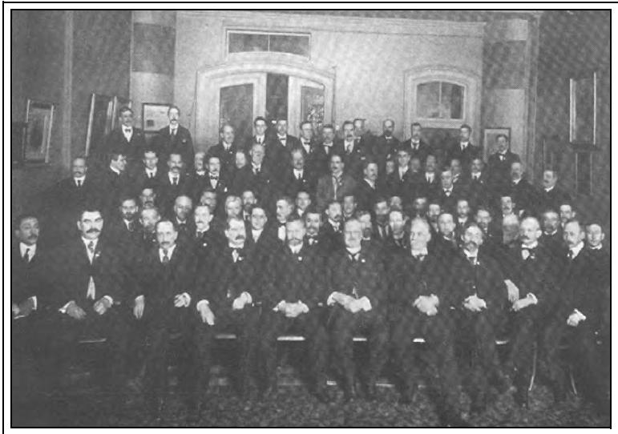
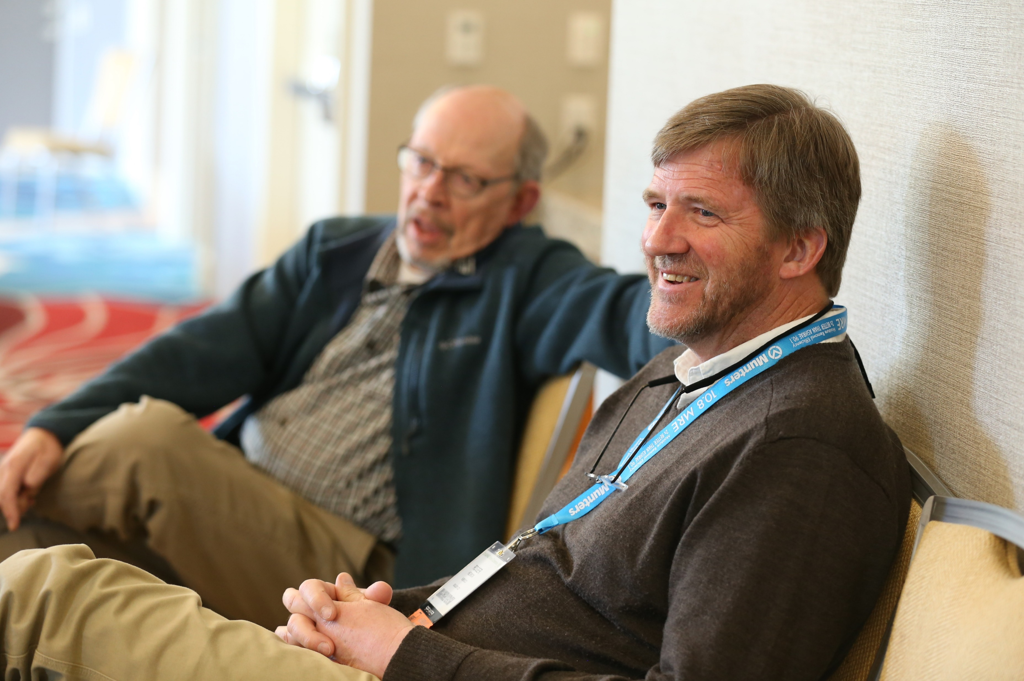
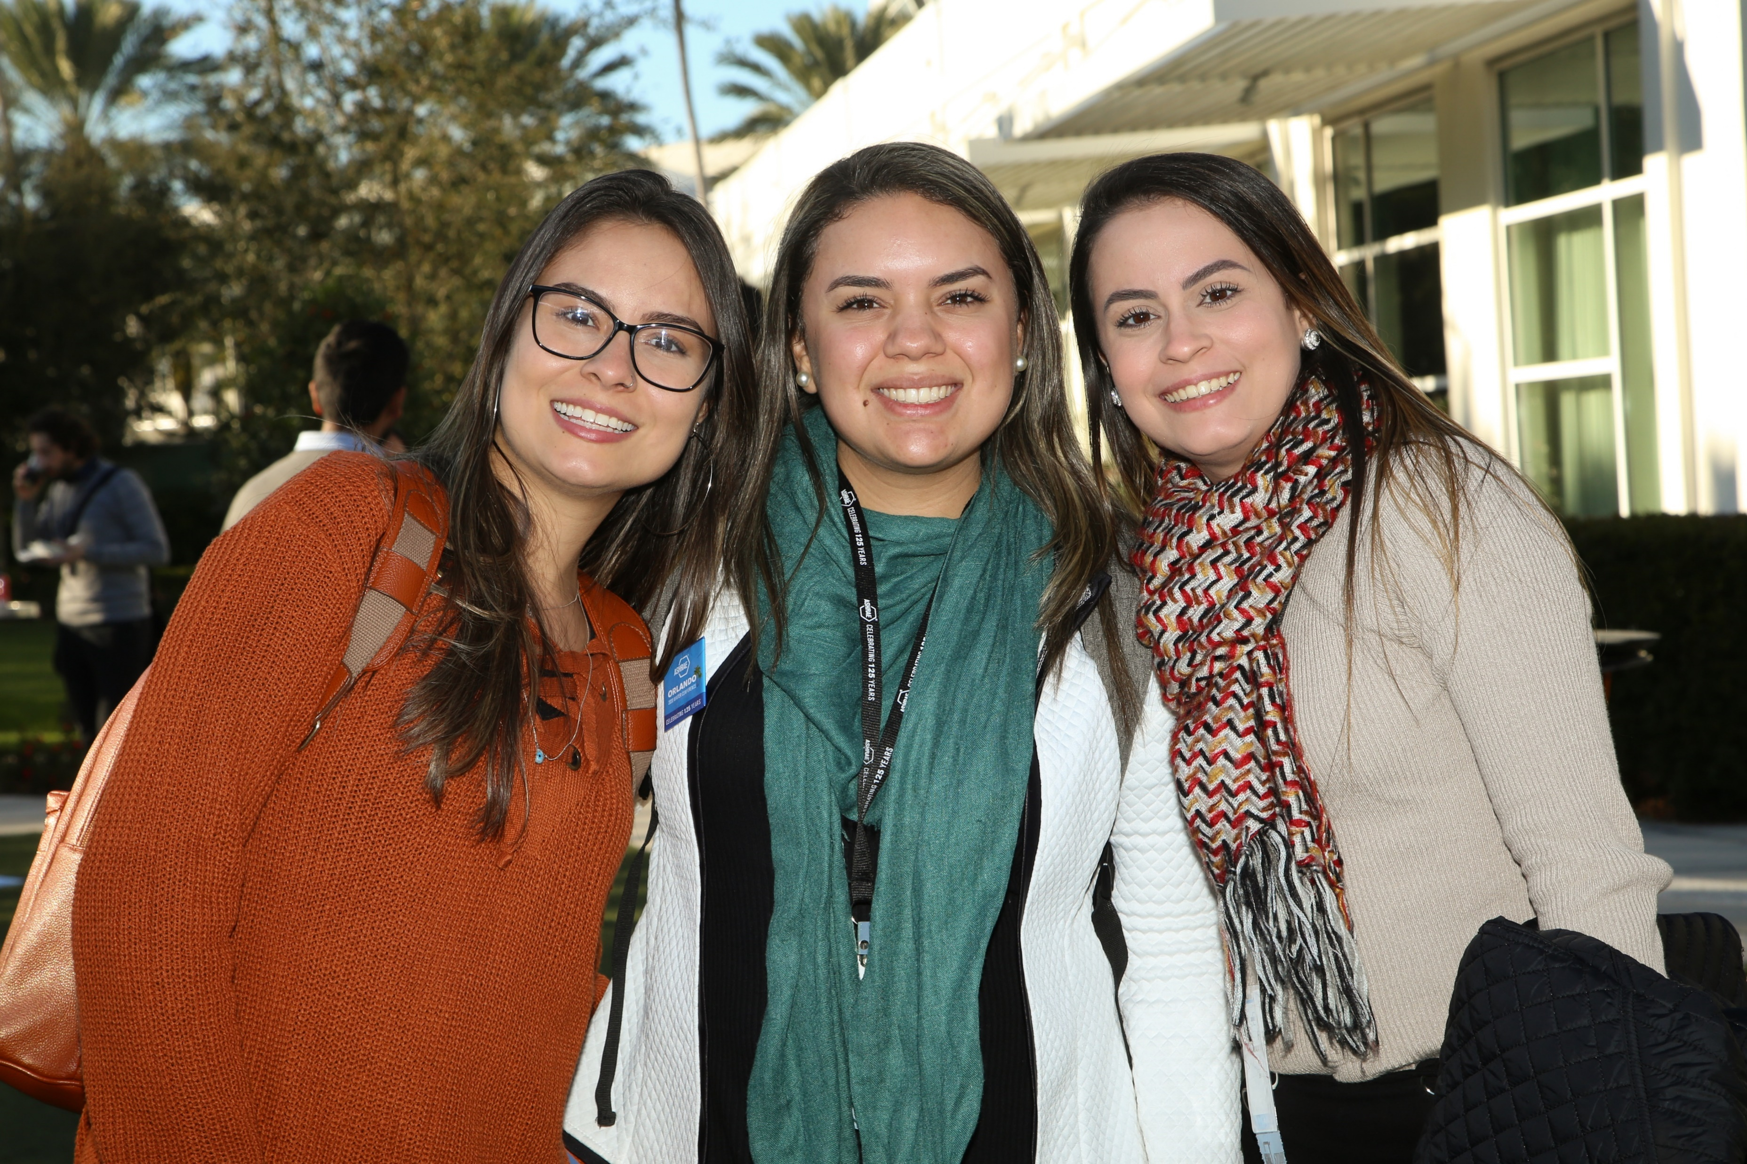
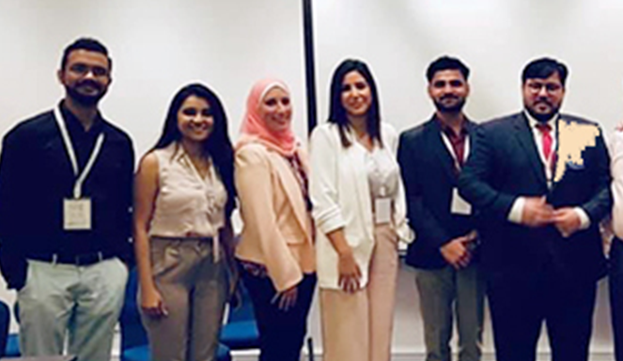
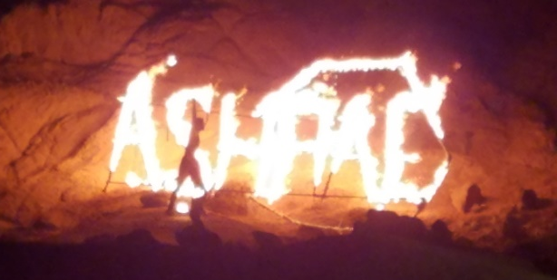
Root Two: Chapters and Region (grassroots)
Together we make ASHRAE Extraordinary
Notes:
We began with our 1906 convention make up – where everyone looked like me but some had hair…and we have changed.
[CLICK] The member-to-member connections we have today are astounding and vibrant. Vintage. Young, Women. Men.…global cultures.
So, in addition to our present membership, we’ll continue to broaden inclusion through support of Young Engineers in ASHRAE, Women in ASHRAE and students.
Also, the Board’s new Diversity, Equity and Inclusion subcommittee will recommend ways to reach out to those presently underrepresented within ASHRAE.
[CLICK] Because it’s not one or the other, it’s all of us, together, that make ASHRAE extraordinary.

Slide 22
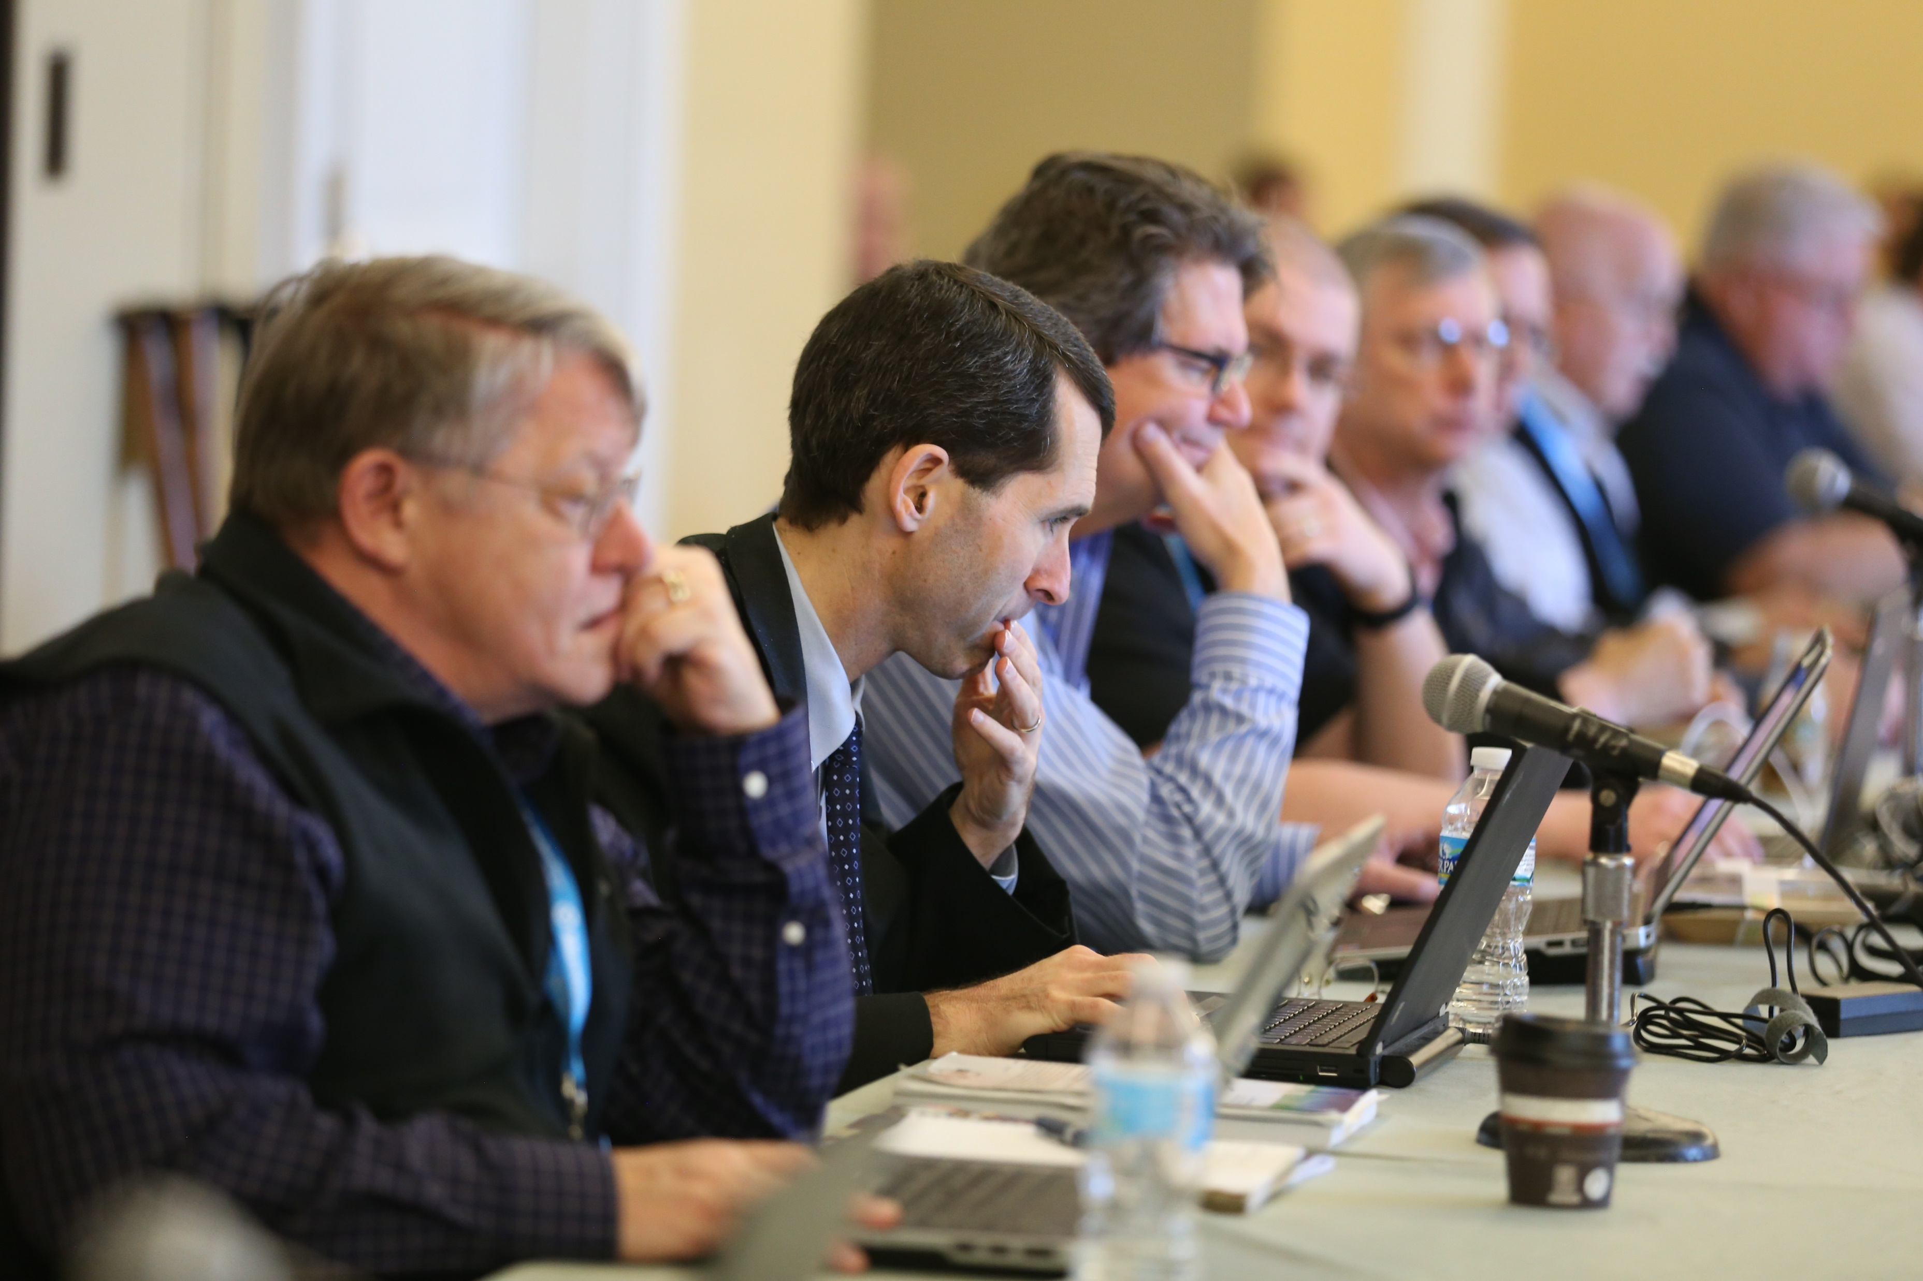
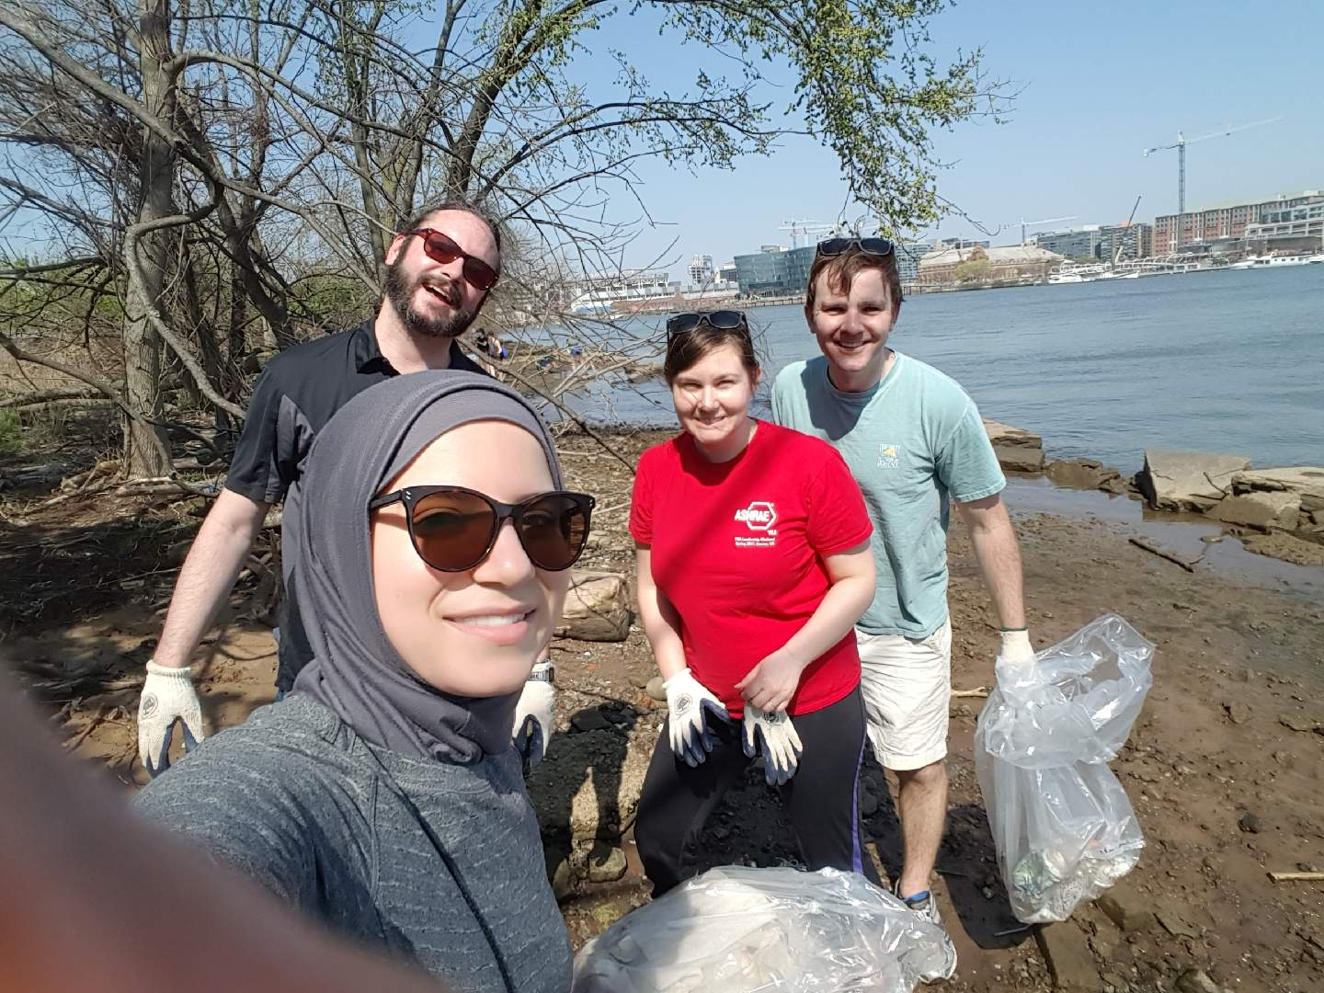
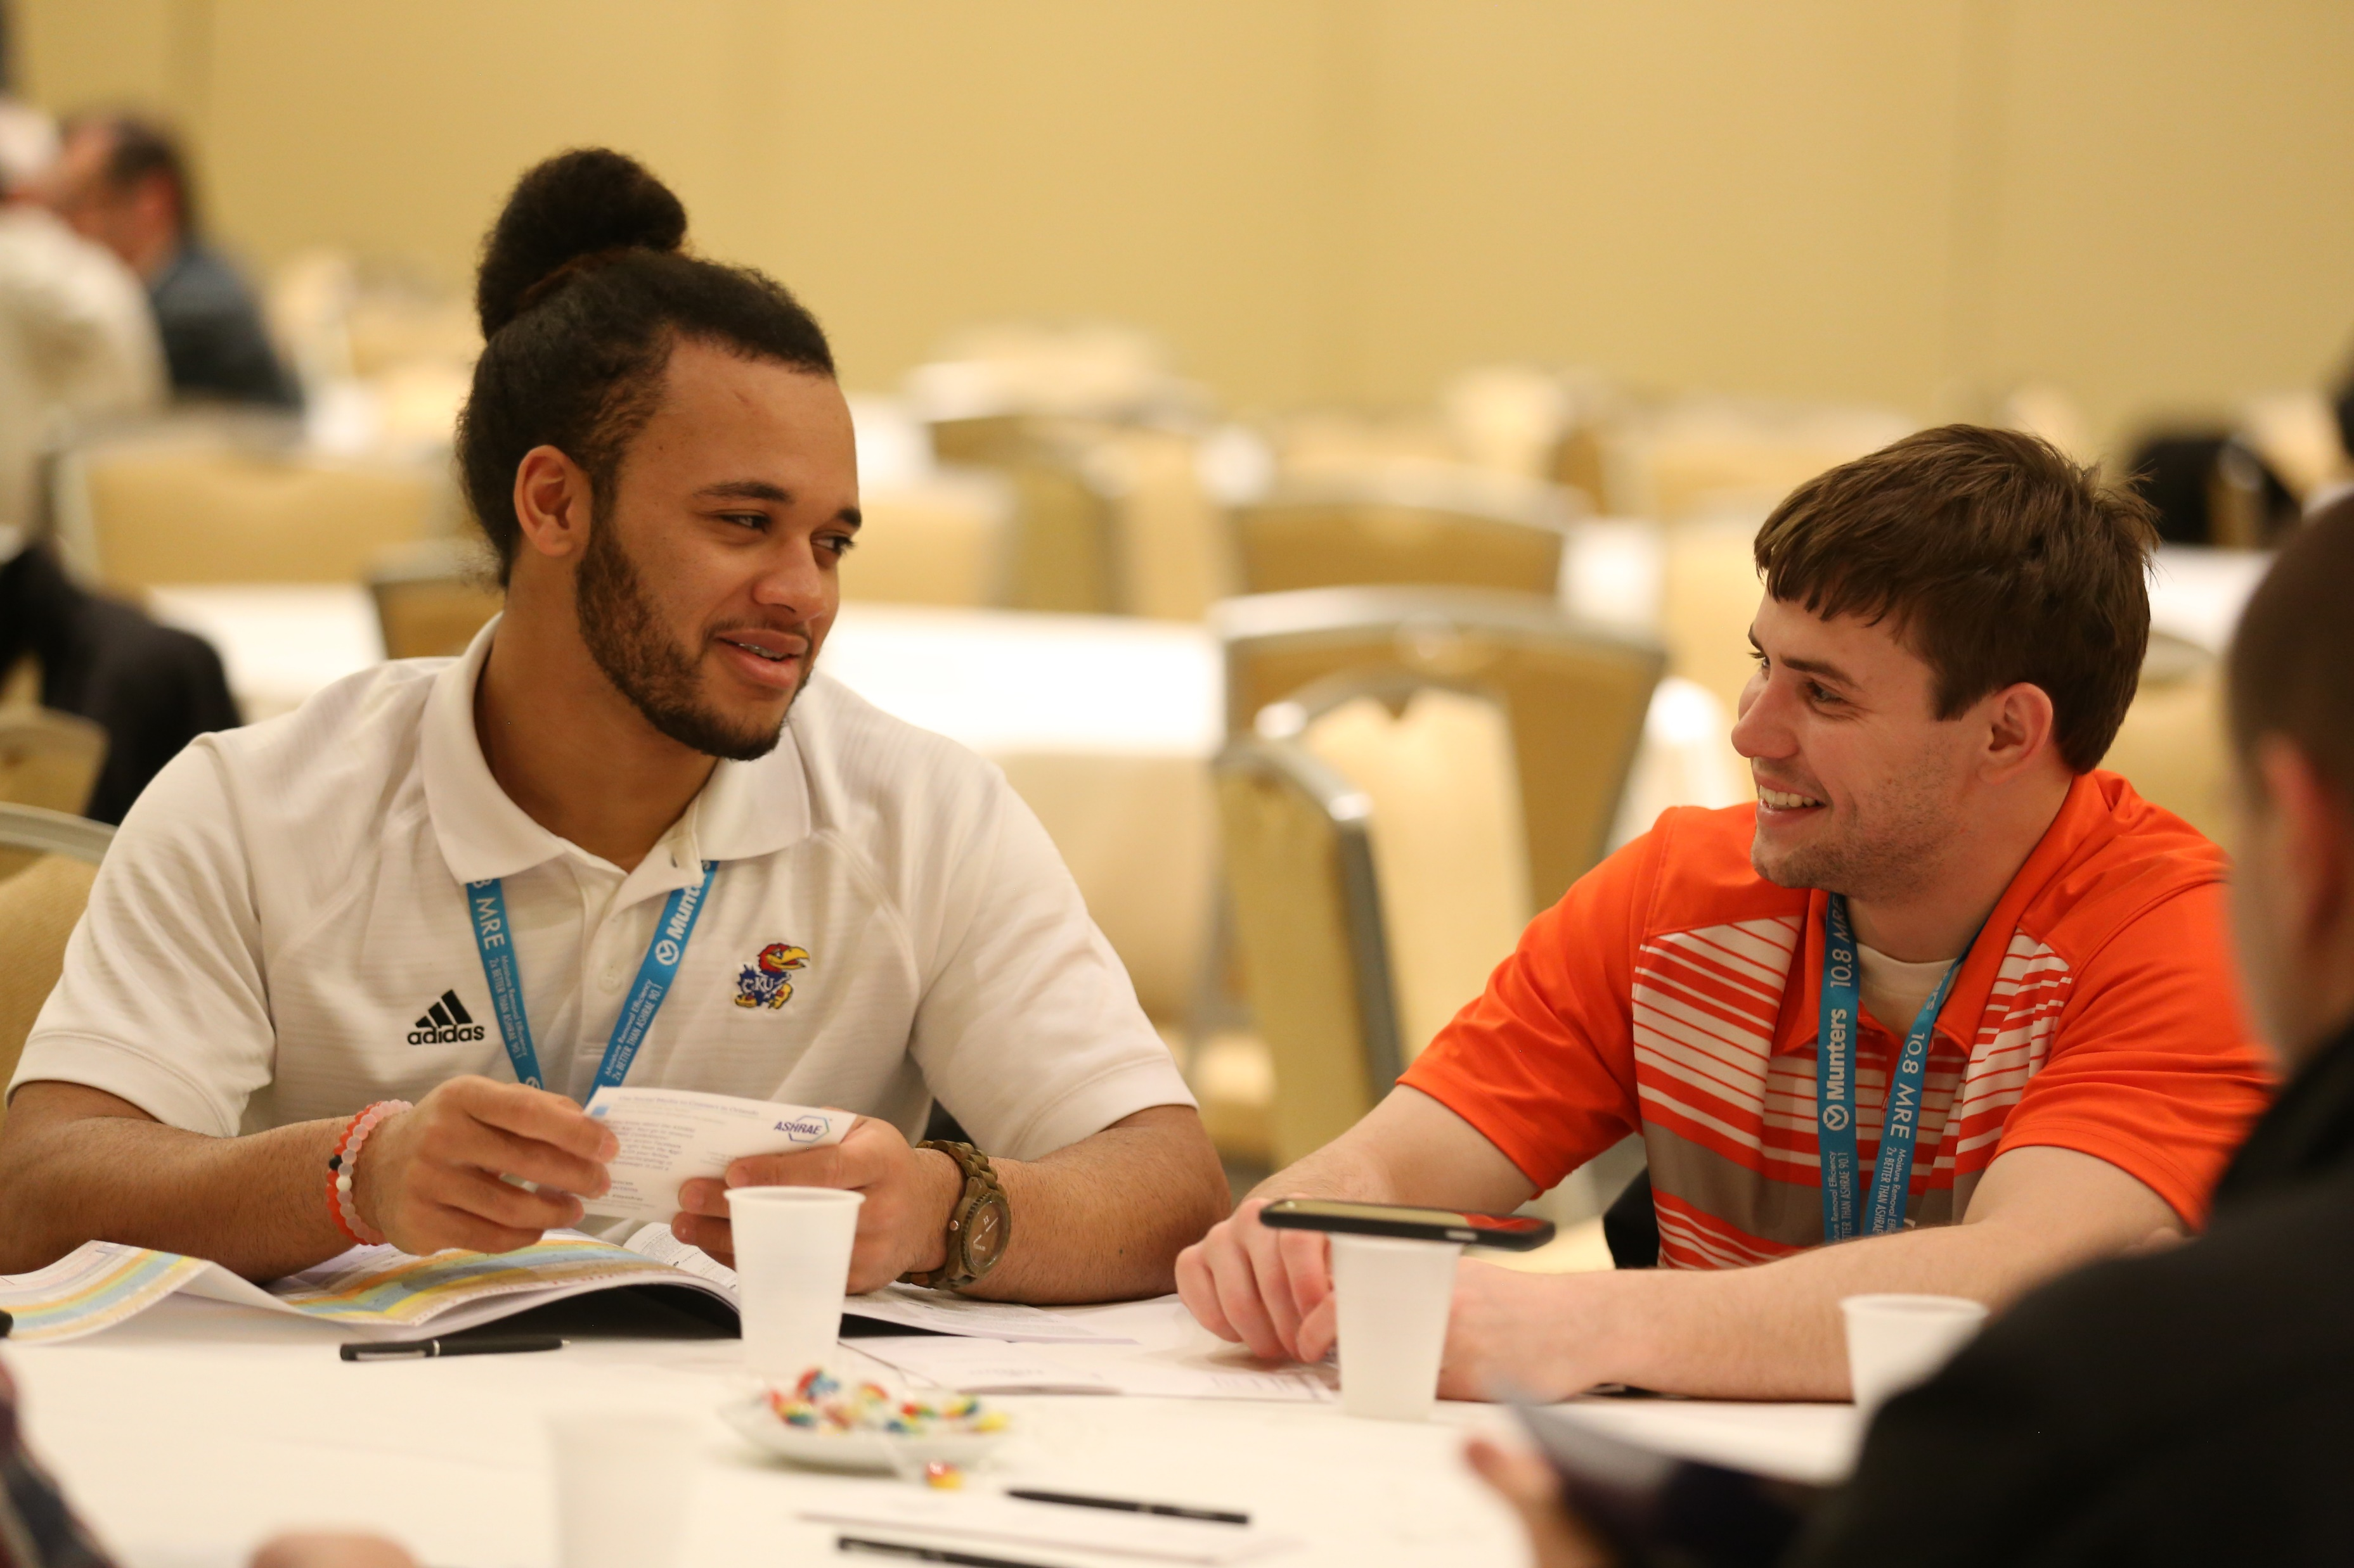
Root One: Personal Growth
NOTHING happens without you, our volunteers
Notes:
And the fact is, nothing happens without each of you – our volunteers.
No matter how you choose to volunteer, you are our lifeblood and provide those resilient, deep and widespread roots that weathered the storm and brought ASHRAE through a global pandemic. You are extraordinary.
Moving forward, three new ways to feed our roots have been developed.
The first provides personal growth.

Slide 23
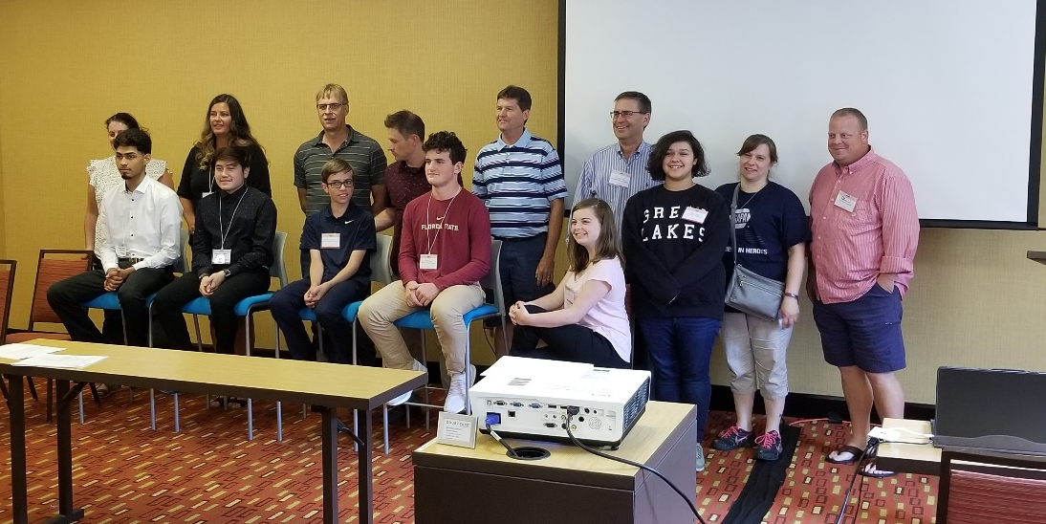
Root One: Personal Growth
Learning Pathways
Pathway 1: HVAC Design.
Young professional
Those new to the industry
Improve knowledge and ability to serve customers
Pathway 2: Pathogen Mitigation
Prepares for future health issues
Notes:
We’ve developed Learning Pathways.
[CLICK] The first pathway is HVAC Design. It’s a curriculum for young professionals, those new to the industry, and others who simply want to serve their customers better.
[CLICK] The second, Pathogen Mitigation, is of very high interest today, and prepares us for future health issues.
Additional pathways will be based on what you want and need!
Our second initiative uses technology - combined with our grassroots to connect with one another and has two parts.

Slide 24
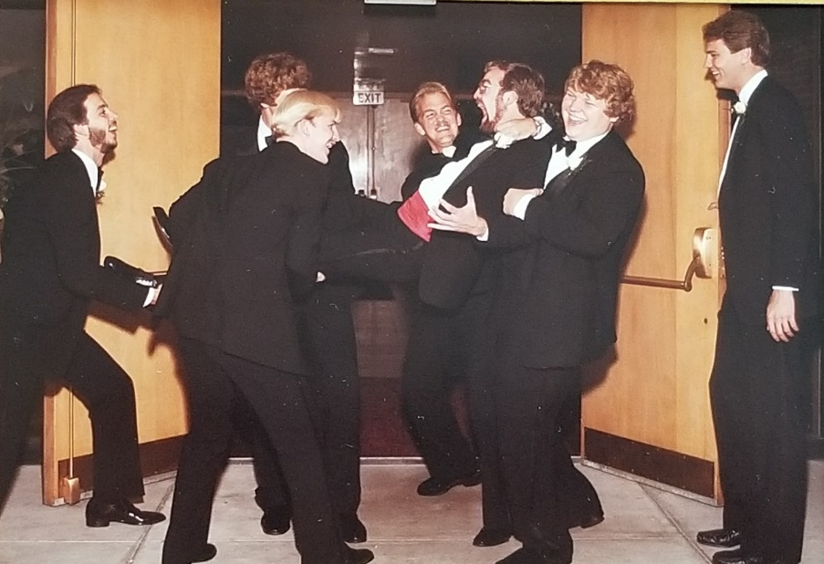
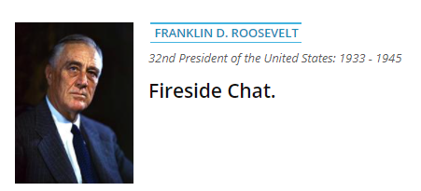
Root Two: Grassroots Member-to-Member Connections
ASHRAE Social Media
@ASHRAE_Society
@ashraepresident
Member-to-Member Connections
Mick and social media
Notes:
ASHRAE is already active on social media platforms – but not all of us participate.
[CLICK] Shown here is a picture of me being dragged kicking and screaming into Jen and my wedding ceremony. And for the record, yes, it’s staged.
[CLICK] I’ve felt the same way about social media.
But social media is a different and more personal way for each of us to connect with our next generation of members.
So your President is enthusiastically on ASHRAE Society’s Instagram page…and I hope you’ll join me.
[CLICK] Second, patterned after U.S. President Franklin Delano Roosevelt’s fireside chats we’ll deliver a series of member-to-member, informal video shorts addressing various topics.
I look forward to seeing you each month.

Slide 25
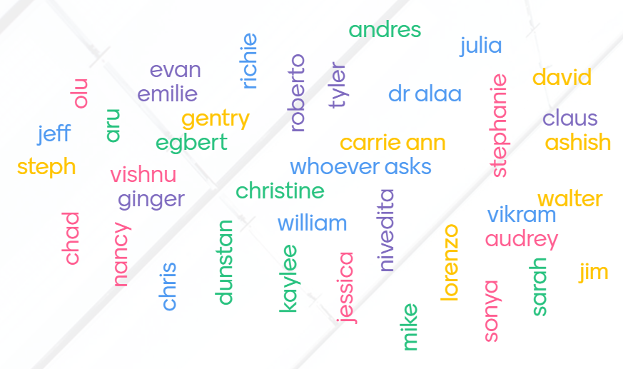
Whose Roots will you feed in the next three months?
Your first list
2-3 first names who fed your roots
Your list to
‘feed the roots’
Notes:
Now, if you take one thing away from today, let it be our final initiative – which includes a request to you.
[CLICK] Earlier, you made a list of people who fed your roots.
Now, it’s time for each of us to give back, and determine whose roots WE will feed
[CLICK] Please take out that list maker again and create another list of 2-3 people whose roots you will feed in the next three months.
It can be friends, professional, ASHRAE, at your workplace, in your community – someone who you already admire, and you want to help them grow.
[CLICK] Now that you’ve made the list…reach out.
Each time you do this, you literally bring us back to our roots of Harrie Crane’s vision for ASHVE 127 years ago…and ASHRAE as we move on to our extraordinary and impactful future.
And whether we’ve helped someone else grow or they’ve helped us, let’s share our “feed the roots moments” – perhaps on social media!

Slide 26
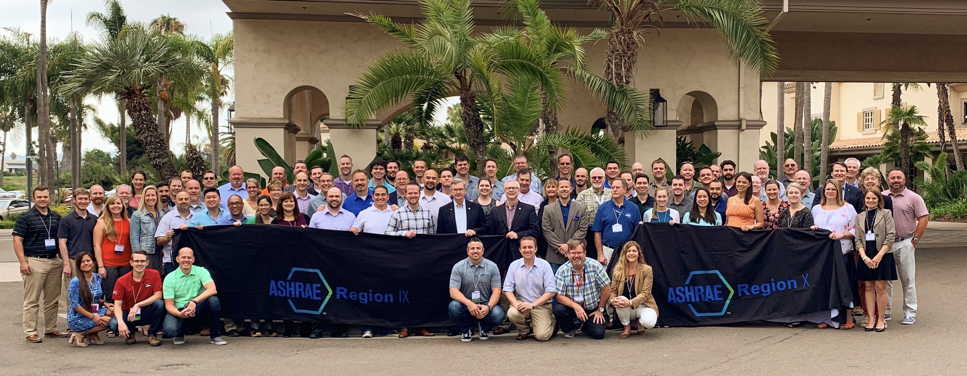
Share Your “Feed the Roots” Moments
2019: Regions IX and X Joint
Chapters Regional Conference
Heather and David Region X
Notes:
Here’s how my roots were fed this past year. It reminded me to feed the personal roots of those closest to us …who sacrifice so much so we can volunteer and serve others.
I knew of Heather through her contributions as a Young Engineer in ASHRAE,
but hadn’t volunteered with her until attending the combined Region 9 and 10 Chapters Regional Conference in August of 2019.
[CLICK] The night before the CRC, I met her husband, David and learned that they were expecting their first child.
Throughout the CRC Heather tirelessly led a very small team – literally 3 to 4 people -- who did all the behind the scenes work to deliver an amazing CRC. What a dynamic and extraordinary volunteer.
Little did Heather and I realize the next time we would see each other would be a year later – during the 2020 Region 10, virtual CRC.

Slide 27
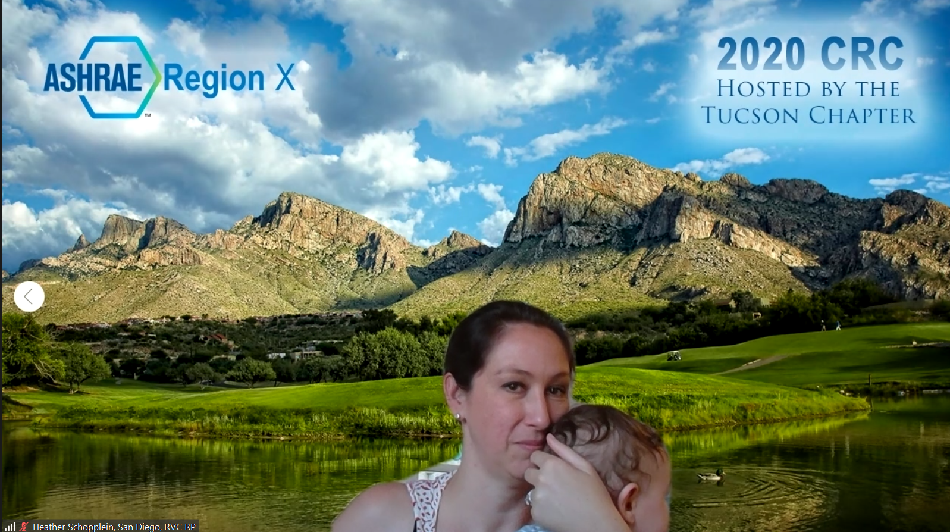
Personal Growth. Global Impact.
Notes:
– and 9-month old Cohen would be with her. Our global impacts serve Cohen and his generation too.
We’ve come full circle.
Guided by our mission we get to serve humanity – every day…and that is an honor and privilege.
We each are involved in ASHRAE for different reasons and volunteer in our chosen ways.
[CLICK] We do it because we grow – professionally and personally – and help others do the same.
We do it because collectively we have tremendous global impact
We do it because that global impact serves the world’s – as well as our personal – future generations.
And all this occurs because we our true to our deep, widespread and strong... technical roots, grassroots and personal roots
Ladies, gentlemen, Feed the Roots.

